Slide 1

Research Internship Summary @ Istituto Italiano di Tecnologia
Presenter:
Job Ledezma
Florianópolis, June - 2016

Slide 2
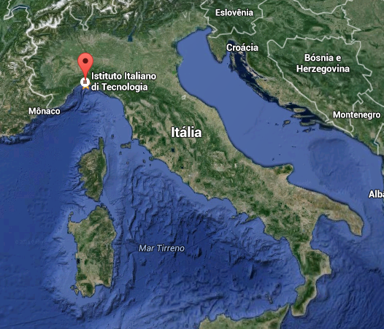

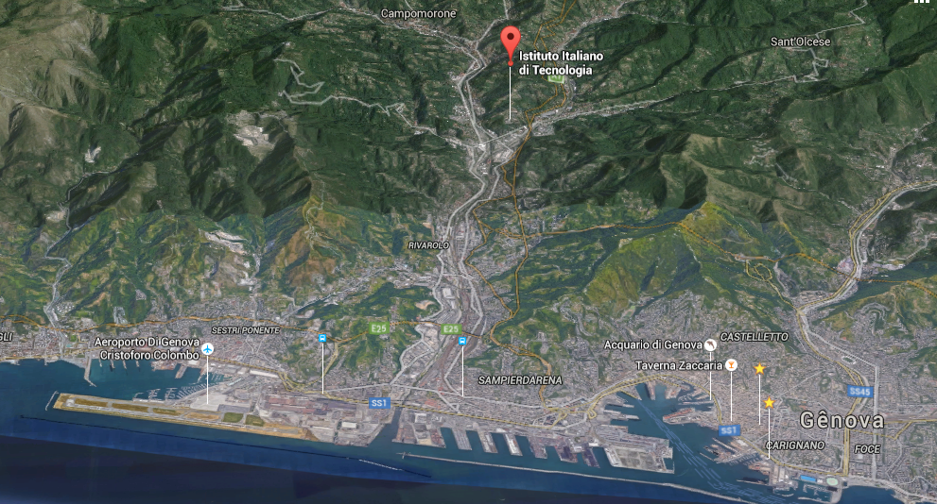
Istituto Italiano di Tecnologia
Via Morego 30, Genova, Itália

Slide 3
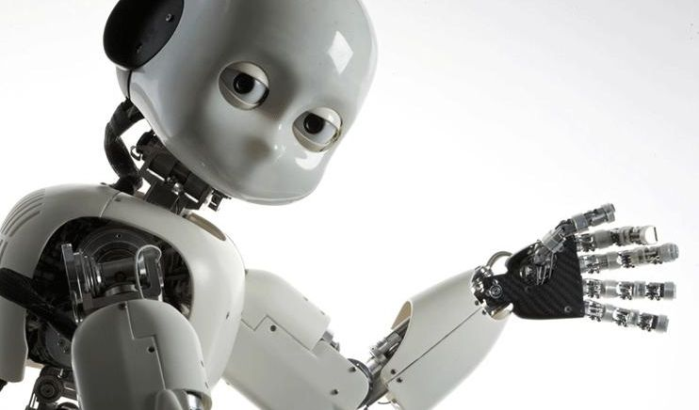
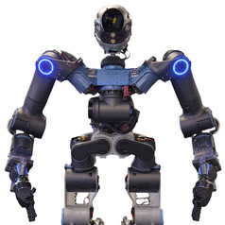
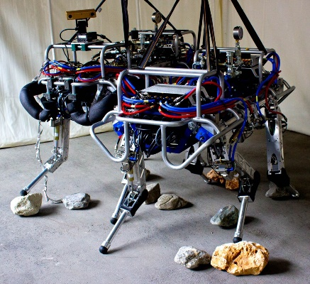
As pesquisas realizadas dentro do Departamento de Robótica Avançada (Advanced Robotics - ADVR) são bastante inovadoras e envolvem pessoal de várias áreas cientificas e de várias partes do mundo com o fim de desenvolver novos componentes e tecnologias a serem aplicadas nos robôs.
iCub
Walkman
Hydraulic
Quadruped
(HyQ)

Slide 4
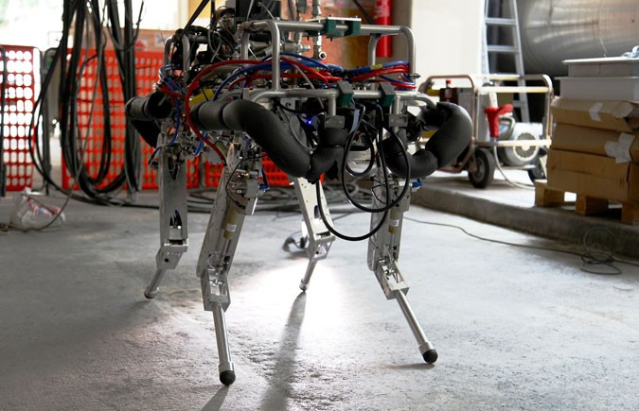
Dynamic Legged Systems Lab
The Dynamic Legged Systems (DLS) lab is performing research and development for the design and control of high-performance, versatile legged robots, including planning and perception. The torque-controlled hydraulic quadruped robot HyQ is their flagship platform.
DLS - Research Highlights
Robot design & Development
Locomotion
Perception
Hydraulic Control
Software

Slide 7
QFT overview
QFT
Was created by the Prof. Isaac Horowitz (1959). It’s a linear technique that adds quantitative characteristic in the frequency analysis initially proposed by Bode (1945).
Quantitative Feedback Theory
Plant model
+
Uncertainties
Performance requirements
Robustness
Performance
Model uncertainties
Disturbances
Bounds
Loopshaping
F
+
G
Quantitative management

Slide 8
QFT overview
QFT is based on a 2-DOF system:
Disturbance at input of the
plant
Disturbance at output of the plant
Controller
Plant
Output
Reference
Prefilter
Sensor
Noise

Slide 9
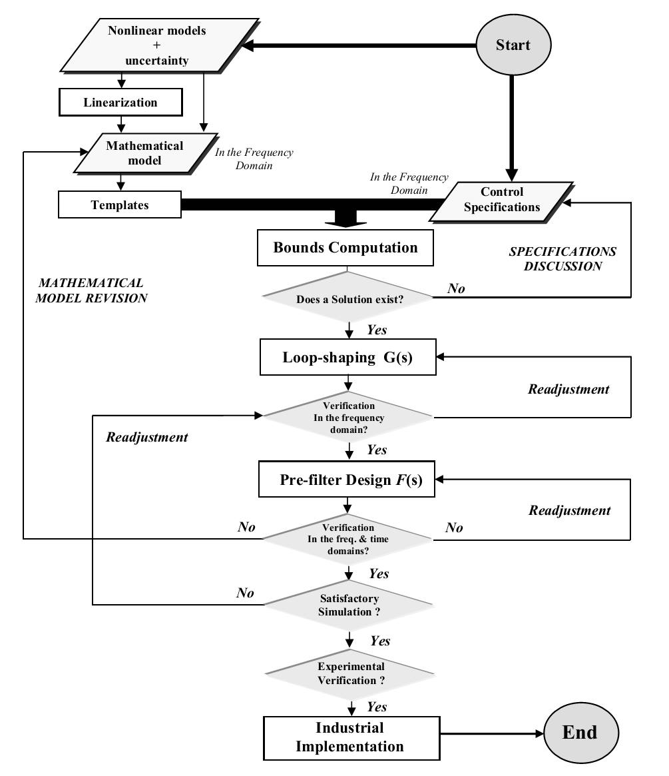
QFT overview
QFT
Procedure

Slide 10
QFT overview
1
Time domain and frequency domain requirements
2
Templates
3
Stability, disturbance and tracking bounds
4
Synthesize nominal L0(s)
5
Loop shaping of the controller G(s)
QFT
Procedure
6
Synthesize the prefilter F(s)
7
Simulations
8
Experimental validation

Slide 11
QFT overview
1
Time domain and frequency domain requirements
TIME DOMAIN SPECIFICATIONS
FREQUENCY DOMAIN SPECIFICATIONS

Slide 12
QFT overview
1
Time domain and frequency domain requirements
Robust stability → δ₁(ω)
Sensitivity → δ₂(ω)
Disturbance rejection → δ₃(ω)
Control effort → δ₄(ω)
Tracking reference
→ δ_{5 inf} (ω) e δ_{5 sup} (ω)

Slide 13
QFT overview
2
Templates
Model of the plant:
K
a₀
a₁
where:
a₀ ∈ [a_{0 min}, a_{0 max}]
a₁ ∈ [a_{1 min}, a_{1 max}]
K ∈ [K_{min}, K_{max}]

Slide 14
QFT overview
2
Templates

Slide 15
QFT overview
3
Stability, disturbance and tracking bounds
Robust stability bound:

Slide 16
QFT overview
3
Stability, disturbance and tracking bounds
Robust stability bound:

Slide 17
QFT overview
3
Stability, disturbance and tracking bounds
Disturbance rejection (Sensitivity at low frequencies):

Slide 18
QFT overview
3
Stability, disturbance and tracking bounds
Disturbance rejection (Sensitivity at medium frequencies):

Slide 19
QFT overview
3
Stability, disturbance and tracking bounds
Disturbance rejection (Sensitivity at high frequencies):

Slide 20
QFT overview
3
Stability, disturbance and tracking bounds
Disturbance rejection

Slide 21
QFT overview
3
Stability, disturbance and tracking bounds
Tracking bound:

Slide 22
QFT overview
3
Stability, disturbance and tracking bounds
Tracking bound:

Slide 23
QFT overview
3
Stability, disturbance and tracking bounds
Intersecting bounds
Joining bounds

Slide 24
QFT overview
3
Stability, disturbance and tracking bounds
Intersecting bounds:

Slide 25
QFT overview
4
Synthesize nominal L0(s)
Integrator:
Proportional gain: 0,038
Zero:
Phase lead filter :

Slide 26
QFT overview
5
Loop shaping of the controller G(s)
Integrator:
Proportional gain: 0,038
Zero:
Phase lead filter :

Slide 27
QFT overview
6
Synthesize the prefilter F(s)
Bode diagram after sinthesizing the prefilter:
Bode diagram before sinthesizing the prefilter:
Pole:
Complex pole:

Slide 28
QFT overview
6
Synthesize the prefilter F(s)
Pole:
Complex pole:

Slide 29
Electrohydraulic Actuator Modeling
Servovalve
Spool movement equation
Flow-rate dynamics
Hydraulic System
Cylinder
Continuity equation
Rod movement equation
Environment
Movement equation

Slide 30
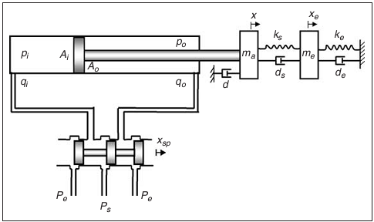
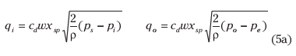
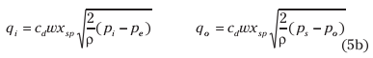
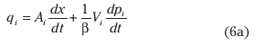
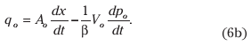
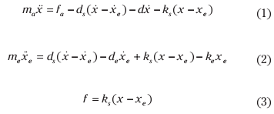
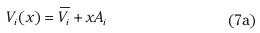
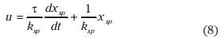
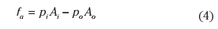
Electrohydraulic Actuator Modeling
Nonlinear differential equations

Slide 31
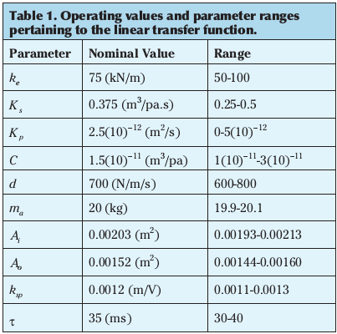
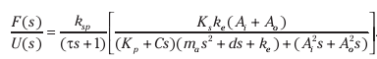
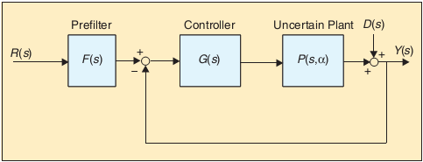
Electrohydraulic Actuator Modeling
Linearized model:
Considering some simplifications:

Slide 32
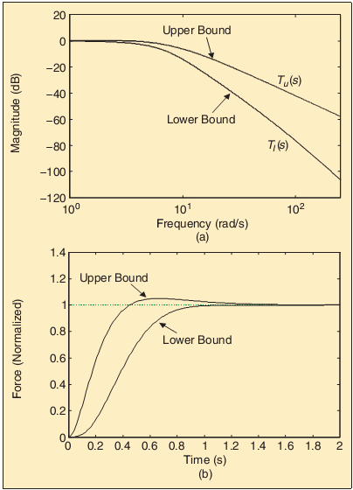
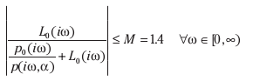
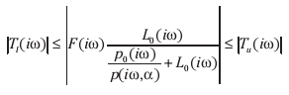
Controller Synthesis
Closed-loop robust stability
The associated QFT robustness constraint in terms of the nominal loop transfer function is given by:
Robust reference input
To meet tracking performance requirements, the controller should satisfy the following inequality:

Slide 33
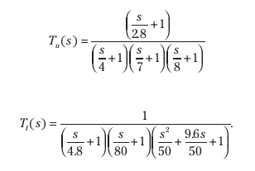
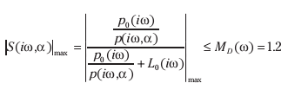
Controller Synthesis
the upper and lower tracking bounds are defined as:
Closed-loop disturbance attenuation (sensitivity reduction)

Slide 34
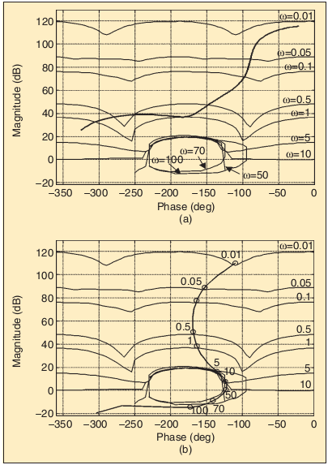
Controller Synthesis
The design specifications impose constraints on the allowable loop gain. These constraints can be shown on a Nichols chart as a curve boundary at each design frequency.
This can be done using a procedure that is called loop shaping in QFT.
Design frequencies are selected as
ω = {0.01,0.05,0.1,0.5,1,5,10,50,70,100} rad/s.

Slide 35
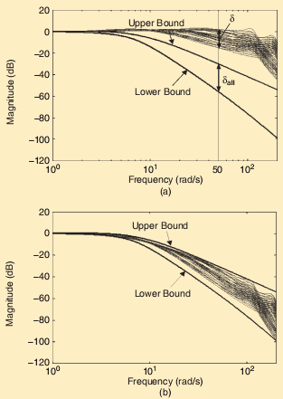
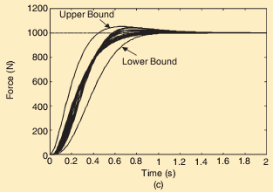
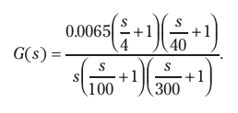
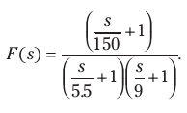
Controller Synthesis

Slide 36
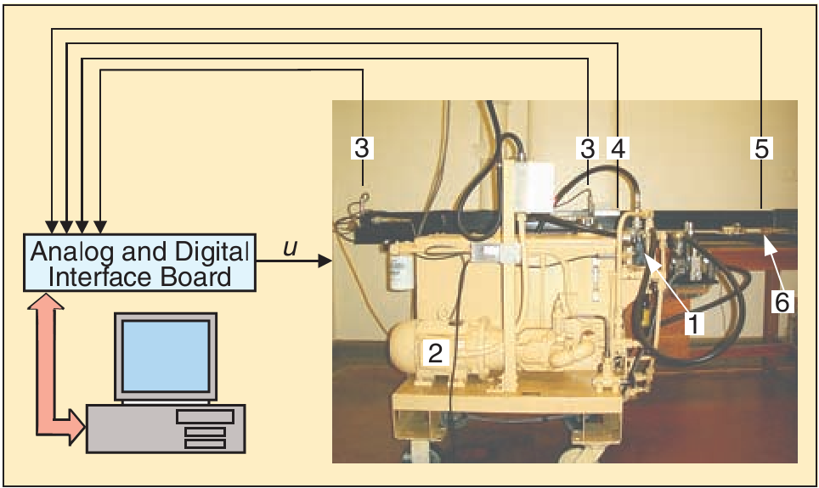
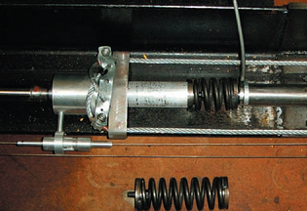
Experiment results
Experimental test station
Proportional valve,
Pump with pressure regulator,
Pressure transducer,
Incremental encoder,
Force sensor,
Environment.

Slide 37
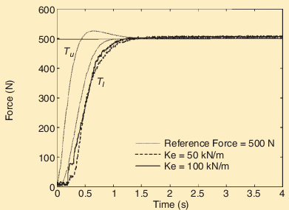
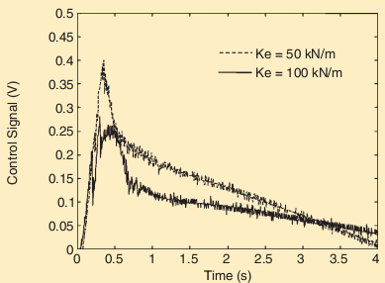
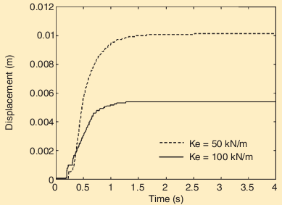
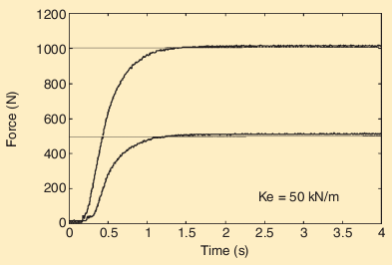
Experiment results

Slide 38
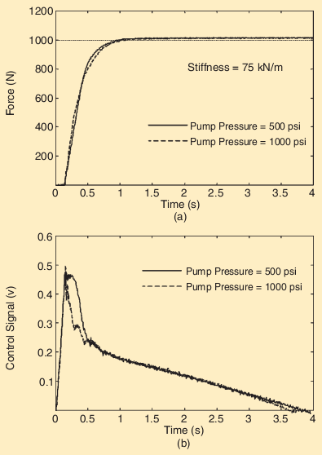
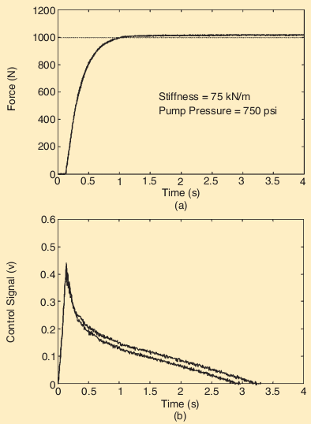
Experiment results

Slide 39
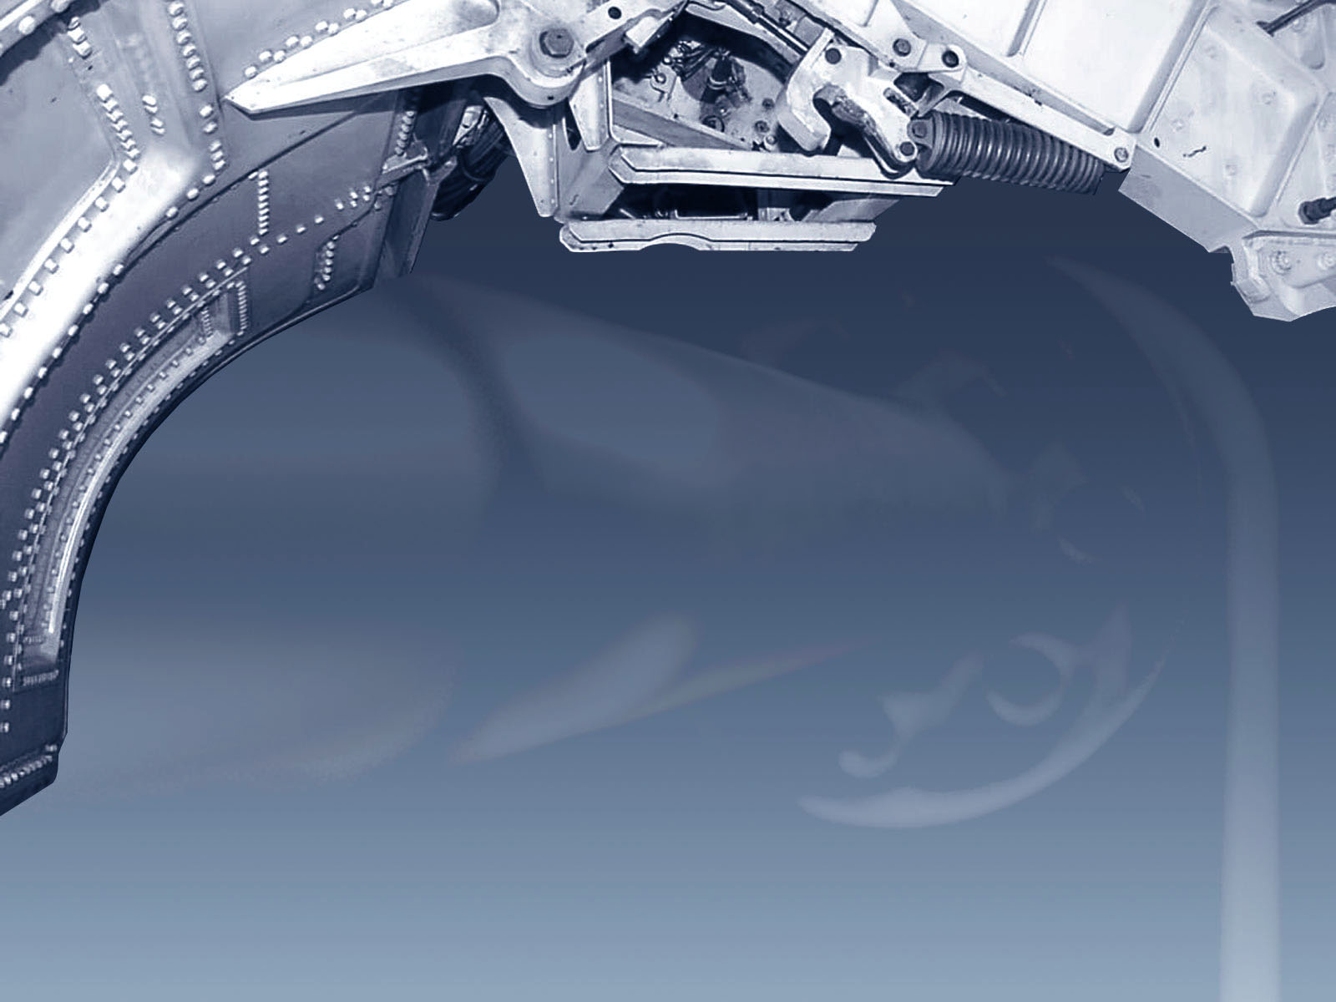
?
?
?
Any questions ??
Thanks !
?

